Slide 1
Identifying Transmembrane Helices in Tertiary Structures
SSBI – Project 3
Marco Klein, Julian Späth, Julius Vetter

Slide 2
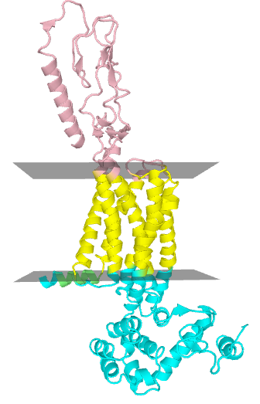
Transmembrane (TM) Proteins
Perform many important physiological tasks
Molecule transport
Cell signaling
Contained substructures
Helix bundle
Beta barrel

Slide 3
Motivation & Goal
Only few determined tertiary structures
PDB entries have no information on membrane topology
Calculate Membrane Geometry
PDB
Entry
Is helix TM?
Helices
TM
Helices
Classifier
Notes:
where the membrane is relative to the protein structure

Slide 4
Data Processing
PDBTM Database
Annotates transmembrane regions in proteins
Find overlap between
Annotated TM regions (PDBTM)
Helix regions (PDB)
Overlap ≥ 70% → positive samples = 0% → negative samples
Additional negative samples from globular proteins
35,000 TM vs 48,000 Non-TM helices
Notes:
we do not use such helices for the training of our model
Dataset size TODO!!!

Slide 5
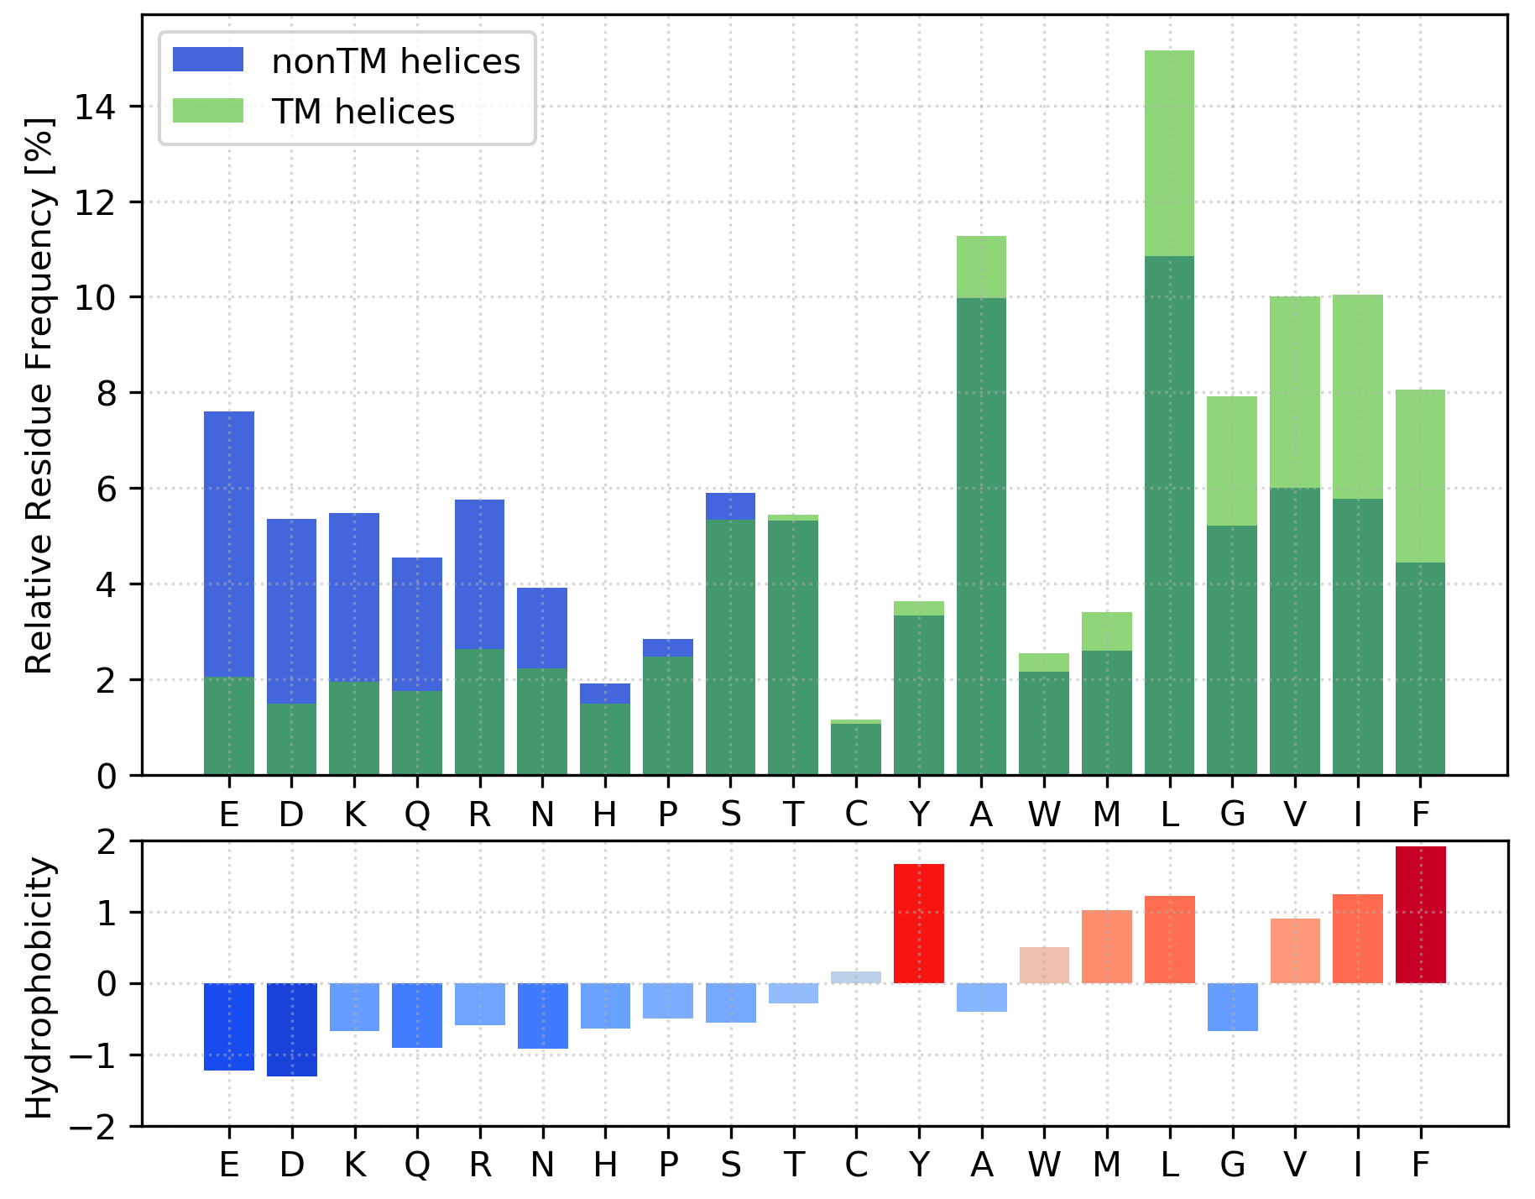
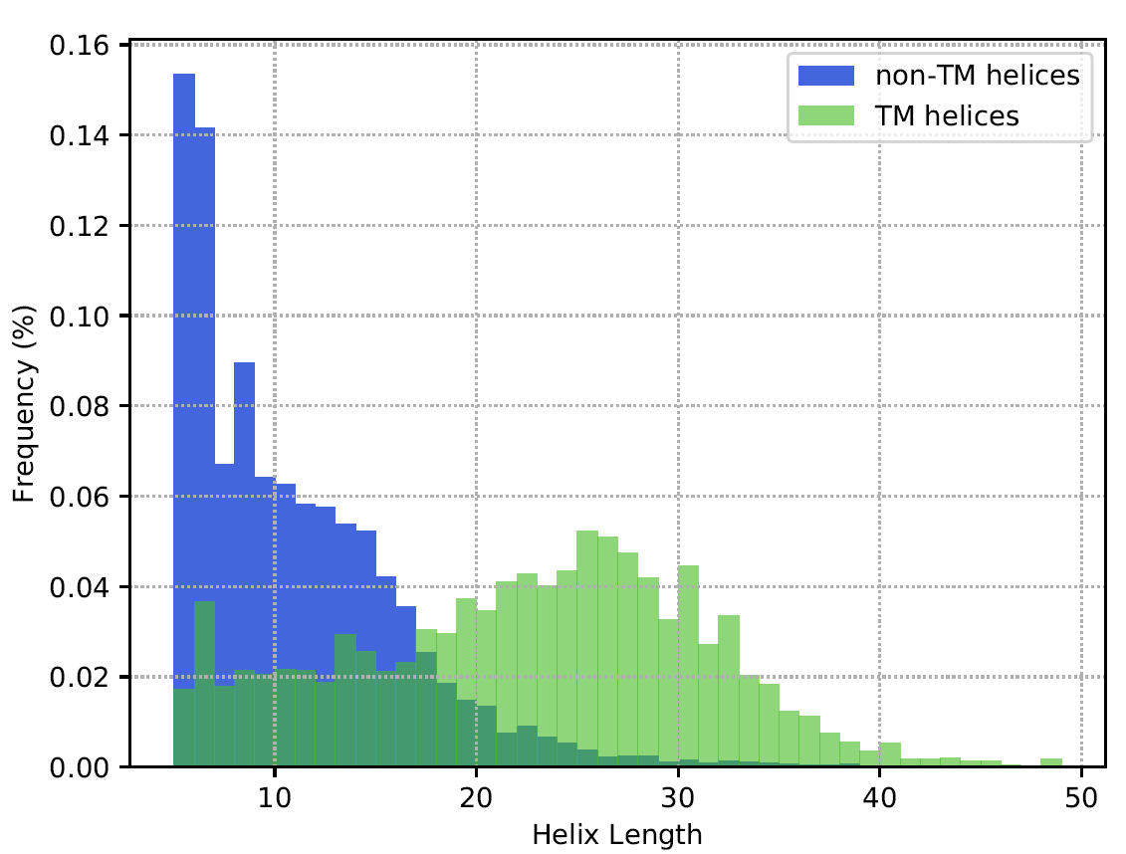
TM vs non-TM helices
Amino Acid composition
Helix length
Notes:
The data has shown some interesting insights into the properties of transmembrane and non-transmembrane helices
The left plot shows the Amino acid composition of transmembrane helices in green and non transmembrane helices in blue. The darker green shows the overlap.
As can be seen some of the amino acids as for example Glutamic acid and Aspartic acid occur much more in non-transmembrane helices. In the plot underneath it can be seen that those amino acids are mostly hydrophilic and therefore have a negative hydrophocity score. On the other hand the amino acids that occur more frequently in transmembrane helices as for example phenylalanine and leucine are mostly hydrophobic.
Furthermore the helix lengths are pretty different: as shown on the right plot the non transmembrane helices in blue containing around are usually shorter than the transmembrane helices where many contain more than 17 amino acids.
1:30 would be nice
the amino acids overrepresanted tend to be hydrophobic and the ones underrepresnented tend to be hydrophilic

Slide 6
Helix Classification
Features: Amino acid counts
Example: PYYTIKDILGALLLILALMLLVL
Classifier: Support Vector Machine (SVM)
Linear and RBF kernels
30 % Test data for evaluation
70 % Training data
5-fold grid search cross validation for SVM parameters (C, γ)
A | C | D | E | F | G | H | I | K | L | M | N | P | Q | R | S | T | V | W | Y
2 | 0 | 1 | 0 | 0 | 1 | 0 | 3 | 1 | 9 | 1 | 0 | 1 | 0 | 0 | 0 | 1 | 1 | 0 | 2
Notes:
Due to that insights we chose the features of our classifier: the amino acid counts which include both the length as well as the frequency information
For an independent evaluation we also split our dataset into a test and training set
The 70% training data was used for the training of an SVM and the parameter optimization which was done by a 5 fold cross validation
tested a wide range of C and gamma

Slide 7
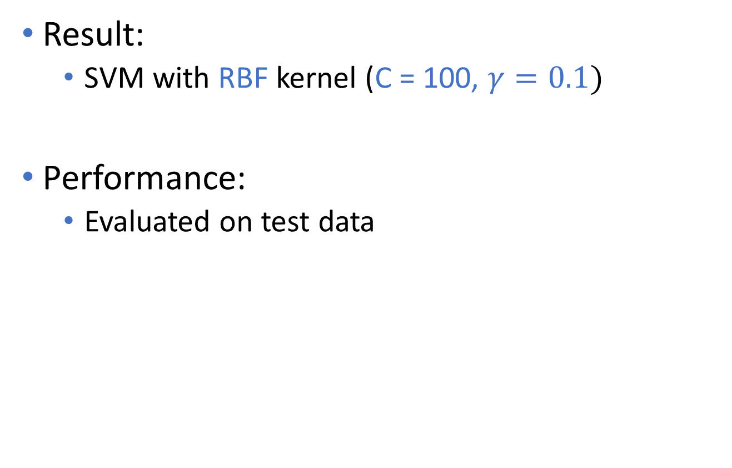
Helix Classification
Result:
SVM with RBF kernel (C = 100, $γ=0.1)$
Performance:
Evaluated on test data
Sensitivity | Specificity | MCC
0.96 | 0.96 | 0.92
Notes:
This cross validation on the training set resulted in a SVM using rbf kernel with C=100 and gamma 0.1
The SVM achieved a sensitivity and specificity of 0.96 and a Matthews correlation coefficient of 0.92 which is a very high.

Slide 8
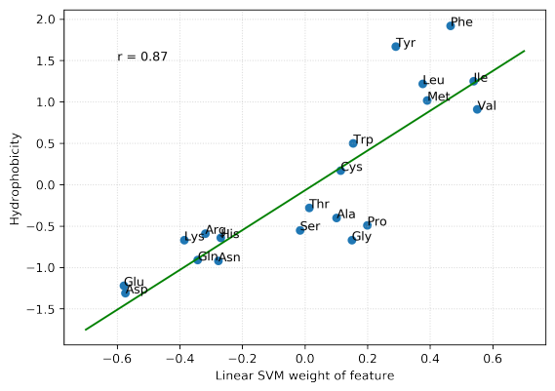
Linear SVM weights
SVM learned hydrophobicity measure without prior knowledge
Notes:
When we looked at the weights of the linear SVM which performed slightly worse than the rbf kernel SVM we saw a high correlation between the weights of each feature which was the amino acid frequency and the corresponding hydrophobicity measure. Therefore the SVM more or less learned the hydrophobicity measure without any prior knowledge.
Out of curiosity we looked at the weights of the linear svm due to them being more easily interpretable and we found that the weights of the deifferent amino acids correspond linearly to their hydrophobicity.
So the linear SVM has implivitly learned to LOOK REPORT!

Slide 9
Membrane geometry calculation
Preliminary geometry
Filter potential FP transmembrane helices via angle and distance information
Remaining helices
→ first PCA loading vector = Membrane normal
Optimisation
Objective function: Q-value (Tusnády, 2004)
Sample test vectors in cone around normal vector
Take vector with highest Q-value

Slide 10
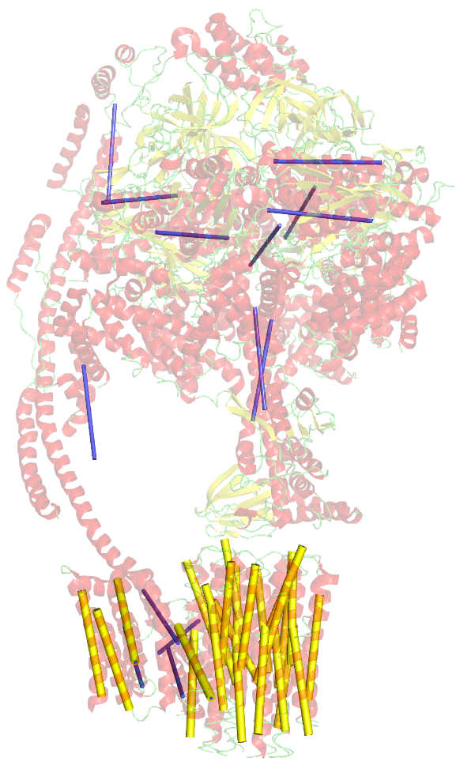
False Positive Removal
Filter helices that are inconsistent with the majority using pairwise distances and angles
Angle and distance criteria filter False Positive helices quite reliably
5ARH
Blue: classified as TM, filtered out
Yellow: used for membrane calculation
Notes:
Using pairwise angles and distances between helices, We filtered those helices that were inconsistent with the majority of the helices. This inconsistency is defined by an angle and distance cutoff

Slide 11
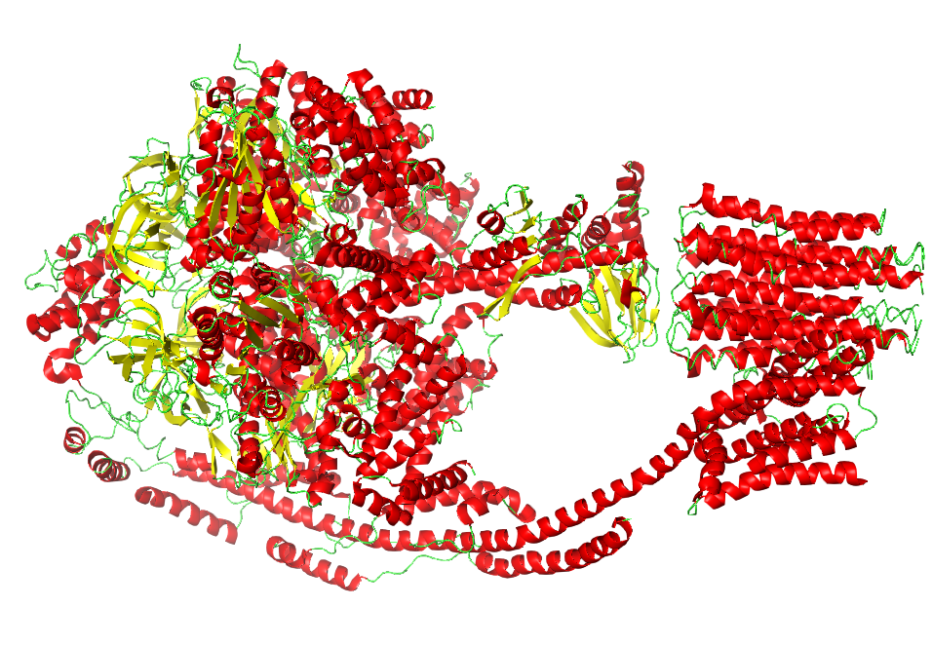
Protein 5ARH
(ATP synthase)

Slide 12
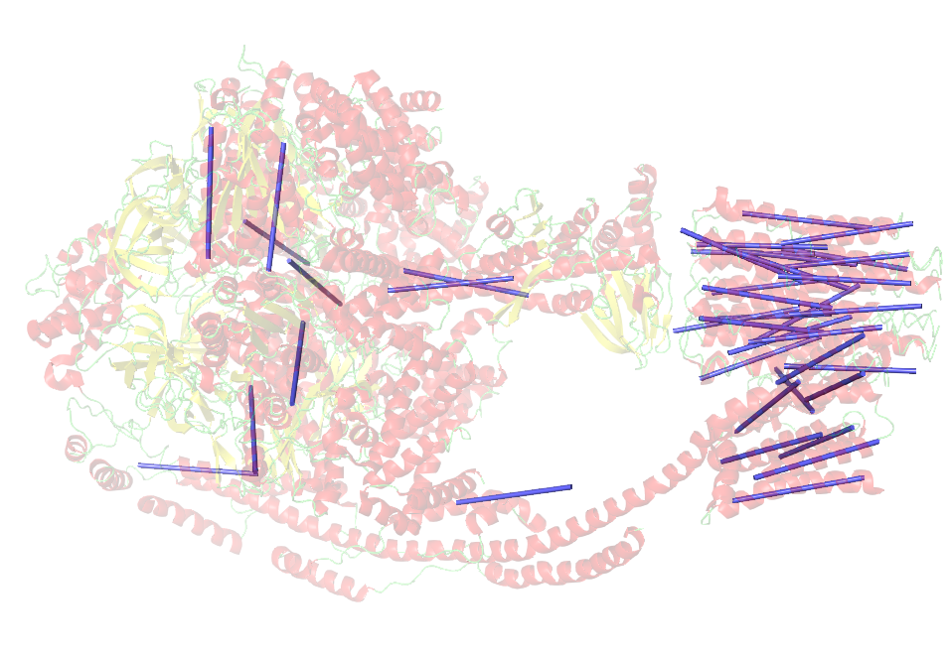
Helices classified
as transmembrane

Slide 13
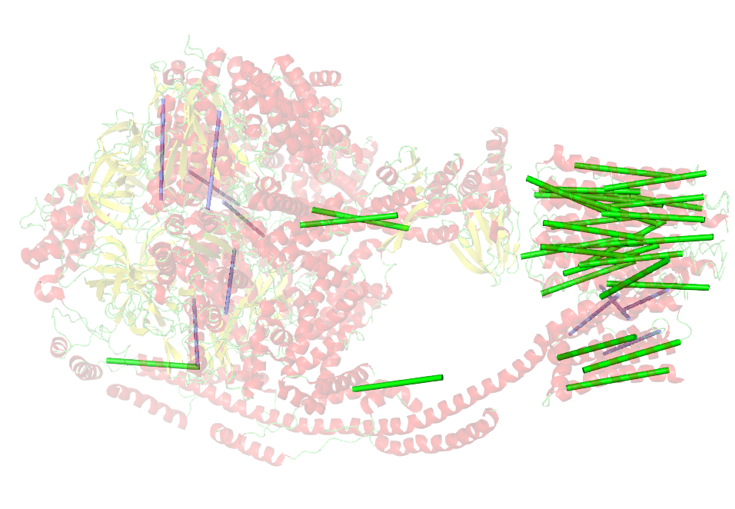
Filter 1:
by angle

Slide 14
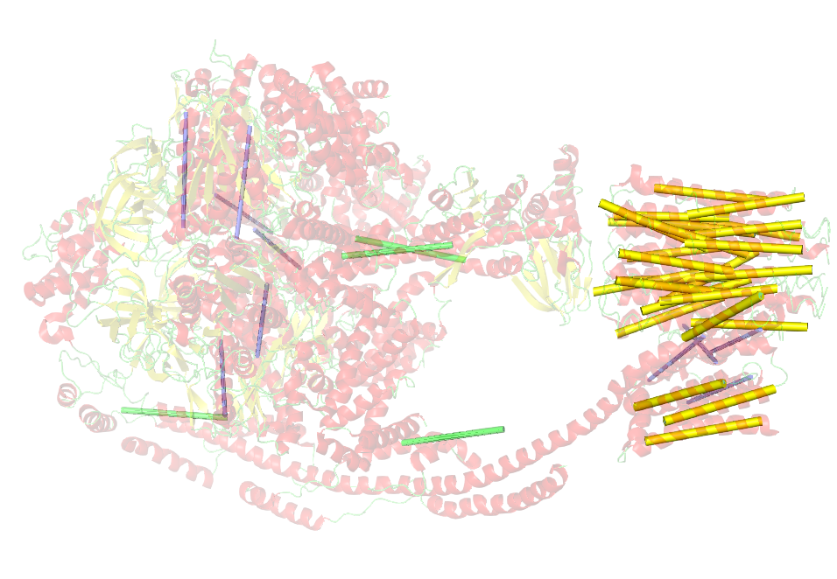
Filter 2:
by distance

Slide 15
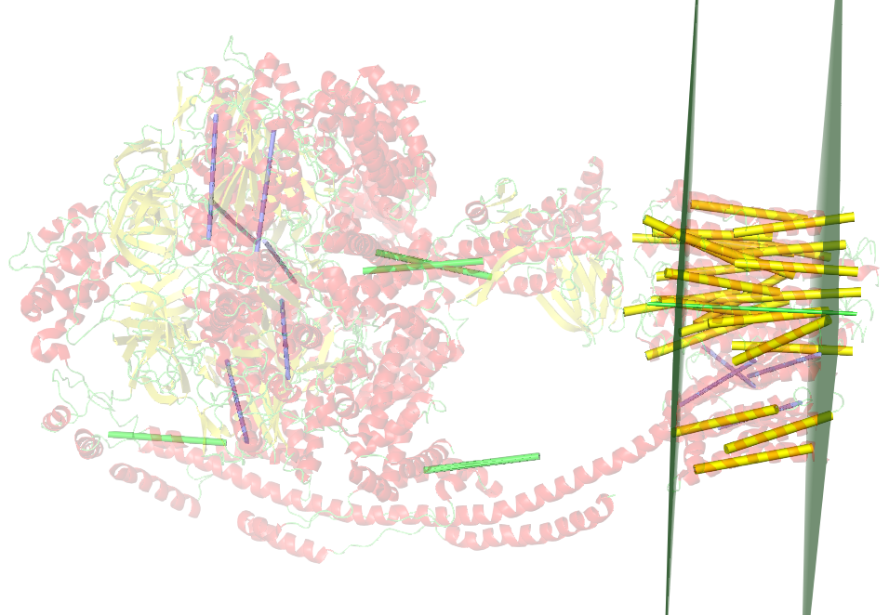
Membrane
calculation

Slide 16
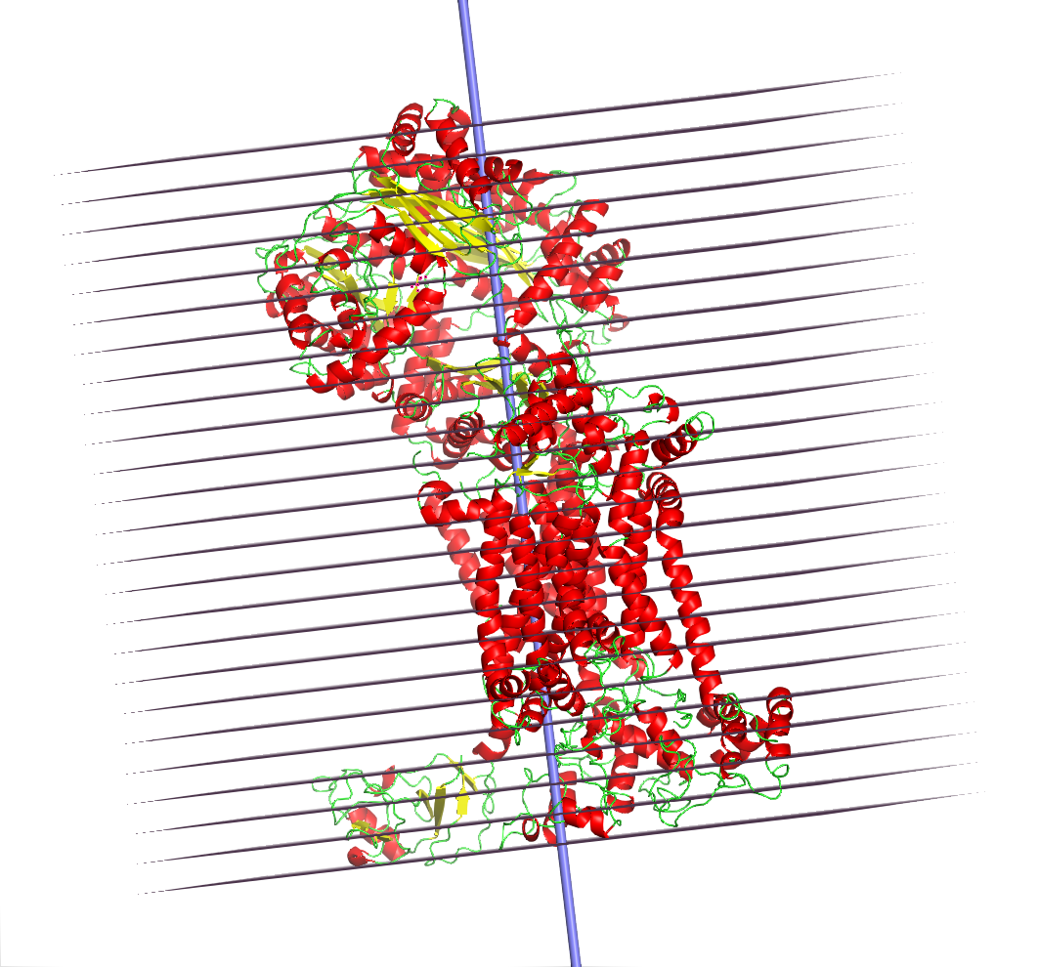
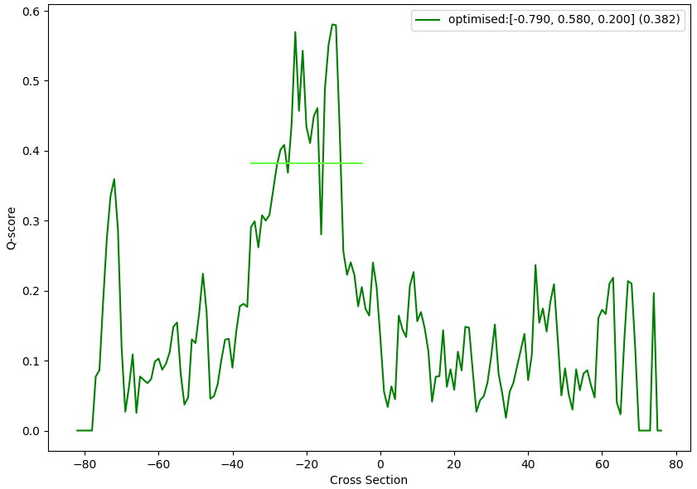
Membrane geometry calculation
Divide tertiary structure into slices
Calculate hydrophobic and geometric factors

Slide 17
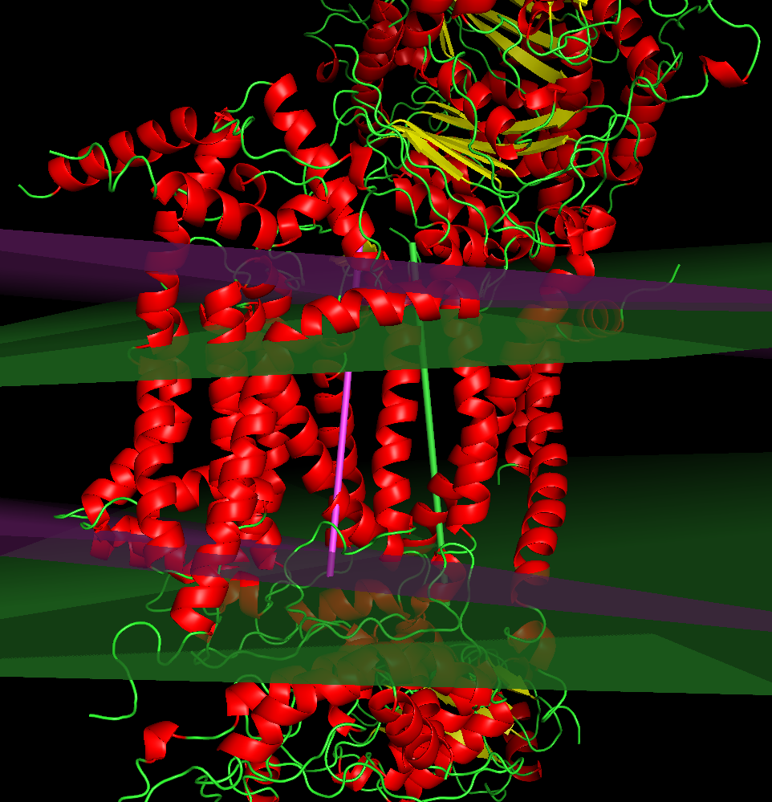
Optimisation result
1BE3, purple: before, green: after

Slide 18
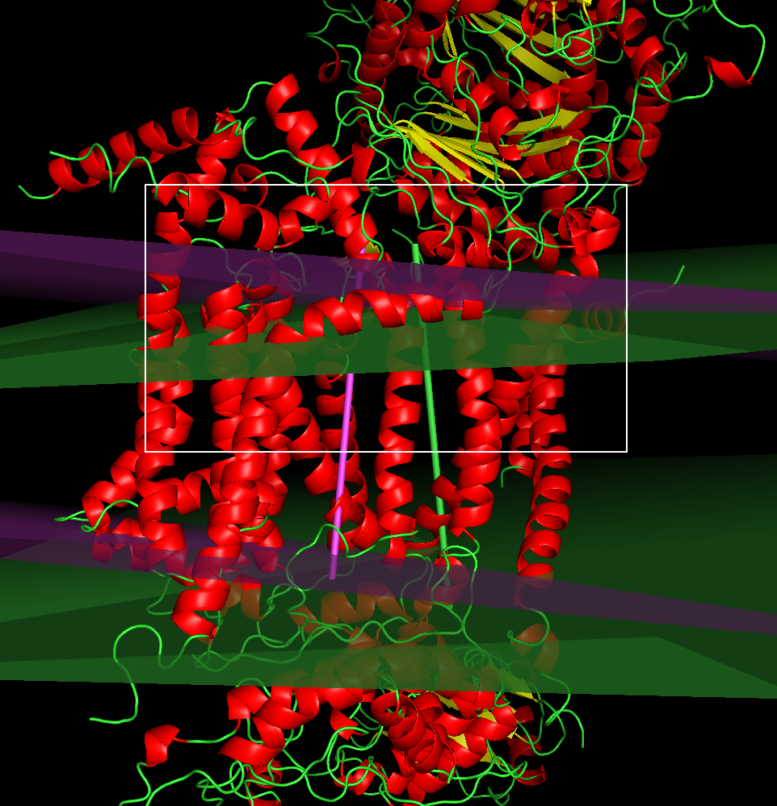
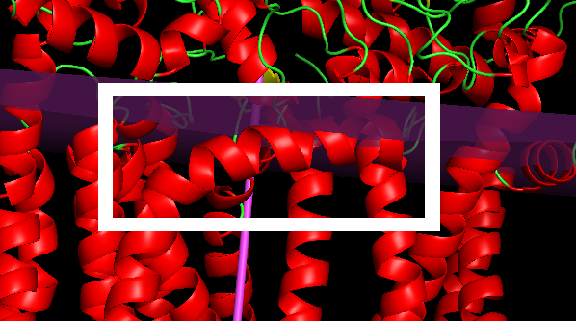
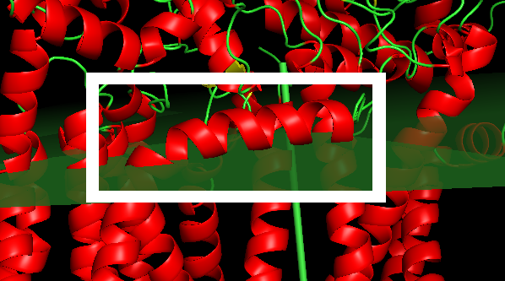
Optimisation result
Before
After
1BE3, purple: before, green: after

Slide 19
Thank you for your attention!

Slide 20
Scores for non-TM proteins
Globulin -> 0.169
Hexokinase -> 0.162

